Slide 1
Loan Analytics & Prediction Systems
Name : Riddhi Panchal (Leader)
Vighnesh Vandra
Rudraksh jadav
Roll No : 2204050200198
2204050200185
2204050200033
Silver Oak University
Sem : 7
IMSC.IT

Slide 2
Introduction
Loan Analytics & Prediction System is designed to help financial institutions analyze applicant data and predict the likelihood of loan approval.
It integrates Machine Learning with data visualization for better decision making.

Slide 3
Problem Statement
Banks and financial institutions face challenges in loan approval due to:
- High risk of loan defaults
- Manual and time-consuming evaluation
- Lack of predictive insights
This project aims to solve these problems using data-driven approaches.

Slide 4
Objectives
1. Analyze historical loan applicant data
2. Identify patterns and correlations
3. Build predictive models to classify loan approval
4. Develop dashboards for visualization
5. Provide insights for decision-making

Slide 5
Dataset Overview
The dataset includes information such as:
- Applicant demographics (Gender, Education, Marital Status)
- Financial details (Income, Loan Amount, Credit History)
- Loan Status (Approved / Not Approved)

Slide 6
Tools & Technologies
- Python (Pandas, NumPy, Scikit-learn)
- Power BI (Interactive Dashboard)
- Jupyter Notebook (Code Development)
- Libraries: Matplotlib, Seaborn

Slide 7
Methodology
1. Data Collection & Preprocessing
2. Exploratory Data Analysis (EDA)
3. Feature Engineering
4. Model Selection & Training
5. Model Evaluation
6. Dashboard Development

Slide 8
Conclusion & Future Scope
Conclusion:
- Loan analytics improves decision-making
- Prediction models help reduce loan default risk
Future Scope:
- Improve model accuracy with more data
- Integrate real-time loan application systems
- Use advanced ML techniques (Deep Learning)

Slide 9
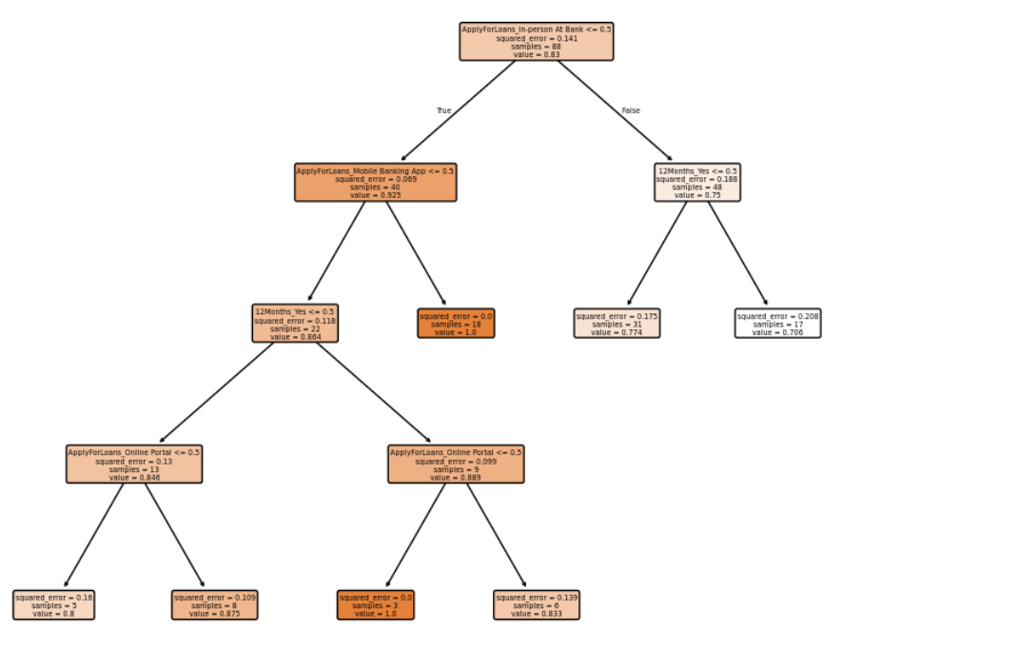
Decision Tree Classifier(EXAMPLE:-)

Slide 10
References
- Loan Prediction
- Python & Power BI Documentation
- Machine Learning Course

Slide 11
Thank YOu

